Slide 1
Architectural Styles – Case Studies
UNIT 2b

Slide 2

Reference

Slide 3


KeyWord In Context
Instrumentation software
Mobile robotics
Cruise control
Three vignettes in mixed style

Slide 4
(1) KWIC

Slide 5
1. KWIC
Keyword indexing is also known as Natural Language or Free Text Indexing.
‘Keyword’ means catchword or significant word or subject denoting word taken mainly from the titles and / or sometimes from abstract or text of the document for the purpose of indexing.
H P Luhn is credited for the development of KWIC index.
This index was based on the keywords in the title of a paper and was produced with the help of computers.

Slide 6
Parts of KWIC
Keywords
Significant or subject denoting words which serve as approach terms.
Context
Keywords selected also specify the particular context of the document (i.e. usually the rest of the terms of the title).
Identification or Location Code
Code used (usually the serial numbers of the entries in the main part) to provide address of the document

Slide 7
KWIC Generation Steps
Mark the significant words or prepare the ‘stop list’ and keep it in computer. The ‘stop list’ refers to a list of words, which are considered to have no value for indexing / retrieval. Ex: an, the, a, etc.
Selection of keywords from the title and / or abstract
KWIC routine serves to rotate the title to make it accessible from each significant term.
Separate the last word and first word of the title by using a symbol say, stroke [/].
Put the identification / location code at the right end of each entry; and finally arrange the entries alphabetically by keywords.

Slide 8
Example
Title
Classification of Books in a University Library
Identification code 1279
Step I: Classification Books University Library
Step II:
CLASSIFICATION of Books in a University Library 1279
BOOKS in a University Library/Classification of 1279
UNIVERSITY Library/Classification of Books in 1279
LIBRARY/Classification of Books in University 1279
Step III:
BOOKS in a University Library/Classification of 1279
CLASSIFICATION of Books in a University Library 1279
LIBRARY/Classification of Books in a University 1279
UNIVERSITY Library/Classification of Books in a 1279

Slide 9
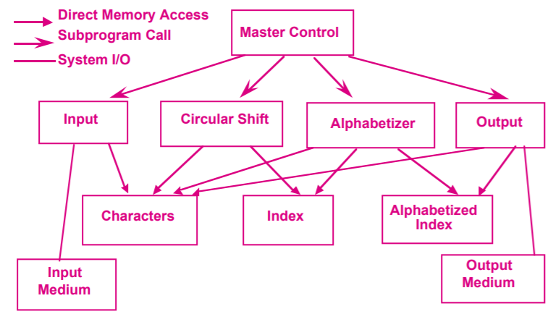
Solution 1: Main Program/Subroutine with Shared Data
The problem is decomposed into four basic functions performed: input, shift, alphabetize, and output.
These computational components are coordinated as subroutines by a main program that sequences through them in turn.
Data is communicated between the components through shared storage (“core storage”).

Slide 10
Comments
Advantages: Computations can share the same storage.
The solution also has a certain intuitive appeal, since distinct computational aspects are isolated in different modules.
Drawbacks: A change in data storage format will affect almost all of the modules.
Changes in the overall processing algorithm and enhancements to system function are not easily accommodated.
Decomposition is not particularly supportive of reuse.

Slide 11
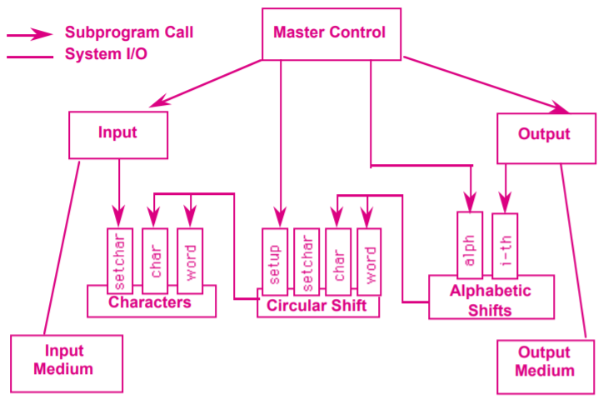
Solution 2: Abstract Data Types
Decomposes the system into a similar set of five modules.
Here data is no longer directly shared by the computational components.
Instead, each module provides an interface that permits other components to access data only by invoking procedures in that interface.

Slide 12
Comments
Advantages
Both algorithms and data representations can be changed in individual modules without affecting others
Reuse is better supported
Drawbacks
The solution is not particularly well-suited to enhancements.
To add new functions to the system, the implementer must either modify the existing modules or add new modules that lead to performance penalties.

Slide 13
Solution 3: Implicit Invocation
Same as Solution 1.
Differences: the interface to the data is more abstract
Computations are invoked implicitly as data is modified.
The alphabetizer is implicitly invoked so that it can alphabetize the lines.

Slide 14
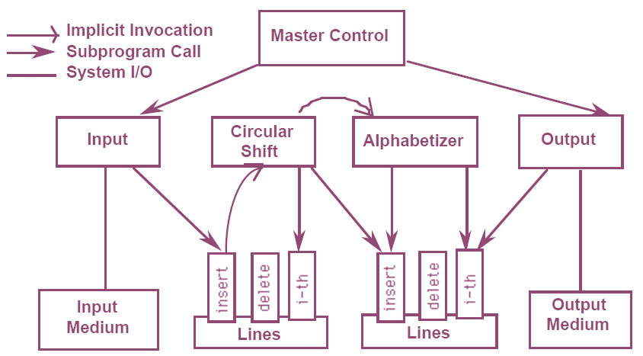
Model

Slide 15
Adv. And DisAdv.
This solution supports functional enhancements to the system - additional modules can be attached
Because data is accessed abstractly, reuse is also supported,
Difficult to control the order of processing of the implicitly invoked modules
Because invocations are data driven, the decomposition tend to use more space than the previously considered decompositions.

Slide 16
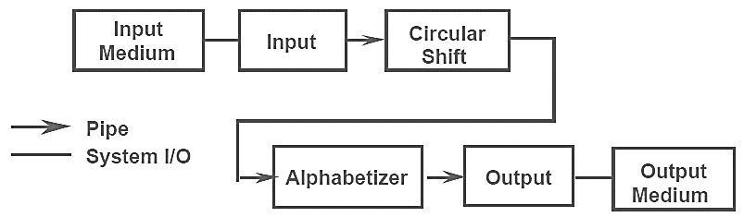
Solution 4: Pipes and Filters
Four filters: input, shift, alphabetize, and output. Each filter processes the data and sends it to the next filter.

Slide 17
Advantages
It maintains the intuitive flow of processing.
It supports reuse, since each filter can function in isolation.
New functions are easily added to the system by inserting filters at the appropriate point in the processing sequence.
It supports ease of modification, since filters are logically independent of other filters.

Slide 18
Disadvantages
It is virtually impossible to modify the design to support an interactive system.
The solution is inefficient in terms of its use of space, since each filter must copy all of the data to its output ports.

Slide 19
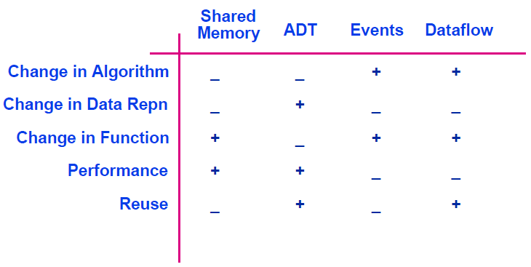
KWIC – Comparison of Solutions

Slide 20
(2) Instrumentation Software

Slide 21
Purpose
The purpose of the project was to develop a reusable system architecture for oscilloscopes.
It is not uncommon for a modern oscilloscope to perform
dozens of measurements
supply megabytes of internal storage
interface to a network of workstations and other instruments
provide sophisticated user interface including a touch panel screen with menus
built-in help facilities
color displays

Slide 22
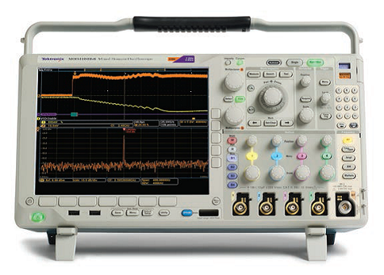
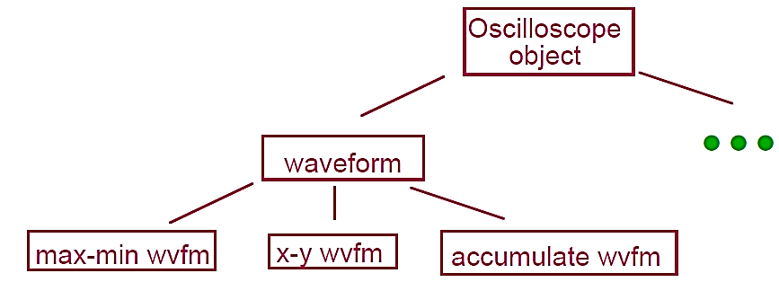
(a) An Object-Oriented model
Data types used in oscilloscopes: waveforms, signals, measurements, trigger modes, etc.
Partitioning of functionality is not clear.
Should measurements be associated with the types of data being measured, or represented externally?
Which objects should the user interface talk to?

Slide 23
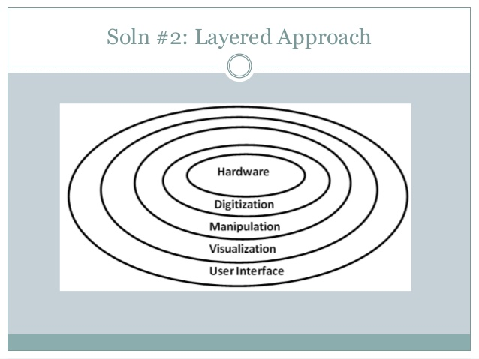
(b) Layered model
Core layer: Signal manipulation functions that filter signals as they enter the oscilloscope. Hardware implementation.
Second Layer: Waveform acquisition. (layer signals are digitized and stored internally for later processing.
Third layer: Waveform manipulation, including measurement, waveform addition, Fourier transformation, etc.
Fourth layer: Display functions. mapping digitized waveforms and measurements to visual representations.
Outermost layer: User interface. which data should be shown on the screen.

Slide 24
Adv & DisAdv.
This layered model was intuitively appealing since it partitioned the functions of an oscilloscope into well-defined groupings.
Unfortunately it was the wrong model for the application domain.
In practice real oscilloscope users need to directly affect the functions in all layers,
setting attenuation in the signal manipulation layer
choosing acquisition mode and parameters in the acquisition layer
creating derived waveforms in the waveform manipulation layer.

Slide 25
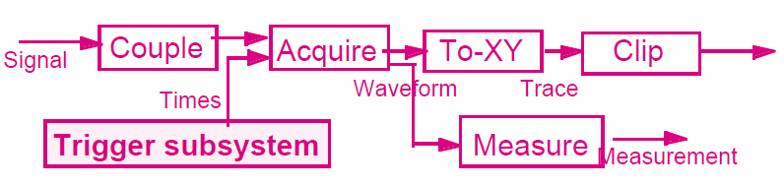
(b) Pipe and Filter Model
Oscilloscope functions were viewed as incremental transformers of data.
Signal transformers - condition external signals.
Acquisition transformers - derive digitized waveforms from these signals.
Display transformers - convert these waveforms into visual data.

Slide 26
Adv. and DisAdv.
Nothing in this model would prevent signal data directly feeding into display filters.
The model corresponded well to the engineers' view of signal processing as a dataflow problem.
The main problem with the model was that it was not clear how the user should interact with it.
If the user were simply at one end of the system, then this would represent an even worse decomposition than the layered system

Slide 27
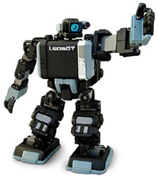
(3) Mobile Robotics

Slide 28
Introduction
Typical software functions.
Acquiring and interpreting input provided by sensors.
Controlling the motion of wheels and other movable parts.
Planning future paths.
Examples of complications.
Obstacles may block path.
Sensor input may be imperfect.
Robot may run out of power.
Mechanical limitations may restrict accuracy of movement.
Robot may manipulate hazardous materials.
Unpredictable events may demand a rapid (autonomous) response.

Slide 29
Design Considerations
Accommodation of deliberate and reactive behavior. Robot must coordinate actions to achieve assigned objectives with the reactions imposed by the environment.
Allowance for uncertainty. Robot must function in the context of incomplete, unreliable and contradictory information.
Accounting of dangers in the robot’s operations and its environment. Relating to fault tolerance, safety and performance, problems like reduced power supply, unexpectedly open doors, etc., should not lead to disaster.
Flexibility. Support for experimentation and reconfiguration.

Slide 30
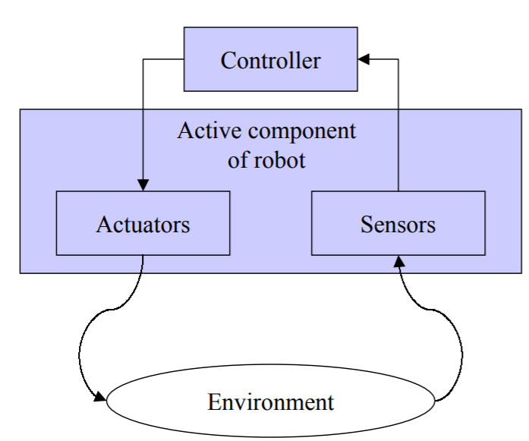
Solution 1: Control loop
Industrial Robots – tasks are fully predefined, Minimal handling of unpredicted events.
Ex: Welding, assembly, packing, etc.
Mobile Robots – closed loop architecture.
Controller initiates robot actions.
Monitors their consequences, adjusting future plans based on this return information.

Slide 31
Evaluation
1. Accommodation of deliberate and reactive behavior. Robot must coordinate actions to achieve assigned objectives with the reactions imposed by the environment.
Simplicity. Problem in more unpredictable environments since there is basic assumption that changes in environment are continuous and require continuous reactions. Basic changes in behavior may be needed when confronted with disparate discrete events.

Slide 32
Contd…
2. Allowance for uncertainty. Robot must function in the context of incomplete, unreliable and contradictory information.
Uncertainty is resolved by reducing unknowns through iteration: a problem if more subtle steps are needed.

Slide 33
Contd.
3. Accounting of dangers in the robot’s operations and its environment. Relating to fault tolerance, safety and performance, problems like reduced power supply, unexpectedly open doors, etc., should not lead to disaster.
Fault tolerance and safety are enhanced by the simplicity of the architecture.

Slide 34
Contd.
4. Flexibility. Support for experimentation and reconfiguration.
Major components (supervisor, sensors, motors) can be easily replaced; more refined tuning must take place inside the modules

Slide 35
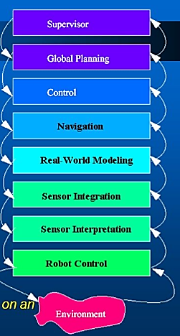
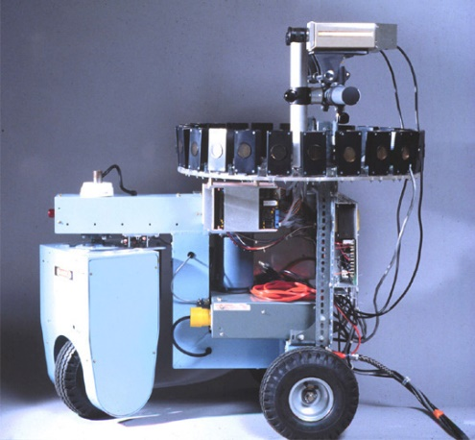
Solution 2: Layered
The figure shows Alberto Elfes' definition of the idealized layered architecture that influenced the design of the Dolphin sonar and navigation system, implemented on the Terregator and Neptune mobile robots.
Neptune

Slide 36
Robot Layers
At level 1, the lowest level, reside the robot control routines (motors, joints,...).
Levels 2 and 3 deal with the input from the real world. They perform sensor interpretation (the analysis of the data from one sensor) and sensor integration (the combined analysis of different sensor inputs).
Level 4 is concerned with maintaining the robot's model of the world.
Level 5 manages the navigation of the robot.
The next two levels, 6 and 7, schedule and plan the robot's actions. Dealing with problems and replanning is also part of the level-7 responsibilities.
The top level provides the user interface and overall supervisory functions.

Slide 37
Adv. & DisAdv.
The abstraction levels defined by the layered architecture provide what constitutes the goal for software architectures in general.
A framework for organizing the components.
It achieves this objective by being precise about the role of the different layers.
The major drawback of the model is that it breaks down when it is taken to the greater level of detail demanded by an actual implementation.
The communications patterns in a robot do most probably not follow the very orderly scheme implied by the architecture.

Slide 38
Solution 3: Implicit Invocation with TCA (Task Controlled Architecture)
TCA organizes components as hierarchies of task called task trees.
Temporal constraints can also be associated with tasks occurring in a task tree.
Tasks communicate by multicasting messages via a message server, which redirects those messages to (one or more) other tasks registered to handle them.
Specific roles of tasks
Exception handlers: can change task trees, for example.
Wiretappers: can see messages going to other tasks.
Monitors: are invoked when message data satisfies predefined conditions.

Slide 39
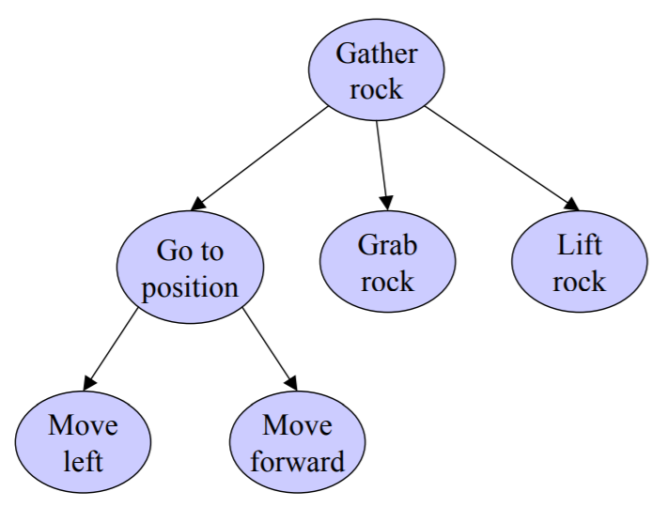
Task Tree
AMBLER
Cheetah

Slide 40
Verdict
1. Accommodation of deliberate and reactive behavior.
Task trees and task roles permit a clear-cut separation of action and reaction. Explicit support for concurrent agents
2. Allowance for uncertainty
Often tentative task trees are created when an exceptional event happens
3. Accounting of dangers in the robot’s operations
TCA exception, wiretapping and monitoring features address needs for performance, safety and fault tolerance.
4. Flexibility
Implicit invocation style supports incremental development and replacement of components

Slide 41
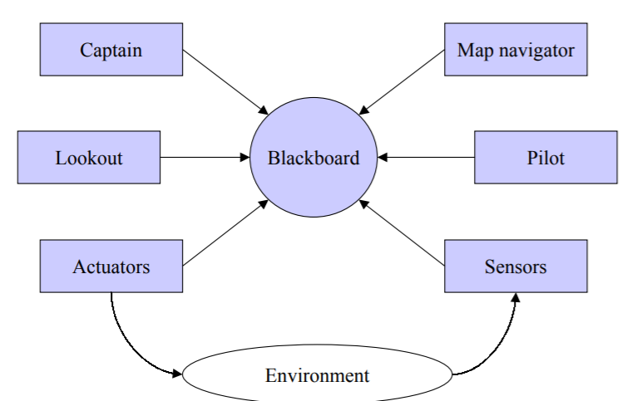
Solution 4: Blackboard Architecture
Captain-overall supervisor
Map navigator-path planner
Lookout-monitors environment
Pilot-low level path planner
Environment – inputs from sensors

Slide 42
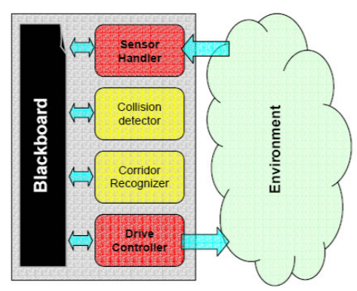
An Experimental Robot

Slide 43
Verdict
1. Accommodation of deliberate and reactive behavior.
Components communicate via the shared repository: modules indicate their interest in certain types of information; the database returns relevant data either immediately or when some other module inserts the relevant data into the database.
2. Allowance for uncertainty
The blackboard helps to resolve conflicts or uncertainty in the robot’s world view
3. Accounting of dangers in the robot’s operations
watch the database for exceptional circumstances
4. Flexibility
Supports concurrency and maintenance by decoupling senders from receivers

Slide 44
(4) Cruise Control

Slide 45
Introduction
On long car journeys drivers find it very tiring to keep up continuous pressure on the accelerator pedal.
To avoid the need to do this many cars now have a system called cruise control.
This is a controller that sits between the driver and the controls of the car (here the throttle that determines how fast the car travels).
The cruise control system allows the driver to set a particular speed and then the controller maintains that speed until the driver changes the speed, uses the brake, or switches the system off.

Slide 46
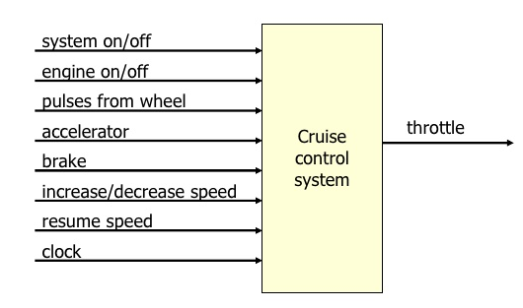
Booch Block Diagram

Slide 47
Inputs
System on/off: If on - maintain the car speed.
Engine on/off: If on, denotes that the car engine is turned on; the cruise-control system is only active if the engine is on.
Pulses from wheel: A pulse is sent for every revolution of the wheel.
Accelerator: Indication of how far the accelerator has been pressed.
Brake: On when the brake is pressed; the cruise-control system temporarily reverts to manual control.
Increase/Decrease Speed: Increase or decrease the maintained speed; only applicable if the cruise-control system is on.
Resume: Resume the last maintained speed; only applicable if the cruise-control system is on.
Clock: Timing pulse every millisecond.
OUTPUT: Throttle: Digital value for the engineer throttle setting.

Slide 48
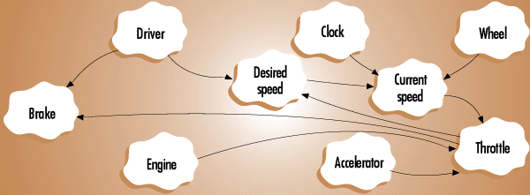
Solution: Object View
Blobs – objects
Arrows - dependencies

Slide 49
Process Control View of CC
Computational Elements
Process definition - take throttle setting as I/P & control vehicle speed
Control algorithm - current speed (wheel pulses) compared to desired speed
Change throttle setting accordingly presents the issue:
decide how much to change setting for a given discrepancy
Data Elements
Controlled variable: current speed of vehicle
Manipulated variable: throttle setting
Set point: set by accelerator and increase/decrease speed inputs
system on/off, engine on/off, brake and resume inputs also have a bearing
Controlled variable sensor: modelled on data from wheel pulses and clock

Slide 50
Control Architecture for CC

Slide 51
State Diagram
The active/inactive toggle is triggered by a variety of events, so a state transition design is natural.
The system is completely off whenever the engine is off. Otherwise there are three inactive and one active state.

Slide 52
Complete CC System
We can now combine the control architecture, the state machine for activation, and the event table for determining the set point into an entire system.

Slide 53
(5) THREE VIGNETTES IN MIXED STYLE

Slide 54
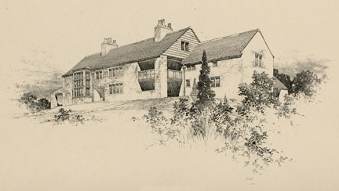
Introduction
The Purpose is to review three systems with mixed styles of architecture
APROVOX process control system
Hayes-Roth Rule Based system
HEARSAY II speech recognition system

Slide 55
Layered Design
The Fisher Controls PROVOX system offers distributed process control for chemical production processes:
Simple control loops to control pressure, flow, levels
Complex strategies involving interrelated control loops
Provisions for integration with plant management and information systems

Slide 56
Layers
Level 1: Process measurement and control: direct adjustment of final control elements.
Level 2: Process supervision: operations console for monitoring and controlling Level 1.
Level 3: Process management: computer-based plant automation, including management reports, optimization strategies, and guidance to operations console
Levels 4 and 5: Plant and corporate management: higher-level functions such as cost accounting, inventory control, and order processing/scheduling.

Slide 57
PROVOX Architecture
Different computation and response times are required at the different levels of the system
Therefore different computation models are used to achieve these results
Levels 1 - 3: object-oriented
Levels 4 - 5: Largely based on conventional data processing repository (database) models

Slide 58
PROVOX-Object oriented elaboration
Seven specialized forms support the most common kinds of control.
Points are, in essence, object-oriented design elements that encapsulate information about control points of the process.
Data associated with a point includes:
Operating parameters, including current process value, set point (target value), valve output, and mode (automatic or manual)
Tuning parameters, such as gain, reset, derivative, and alarm trip-points
Configuration parameters, including tag (name) and I/O channels.

